Slide 1
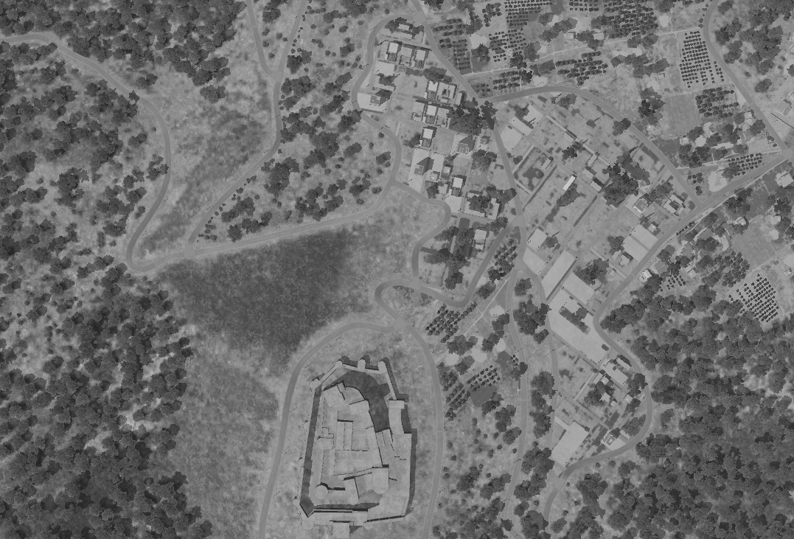
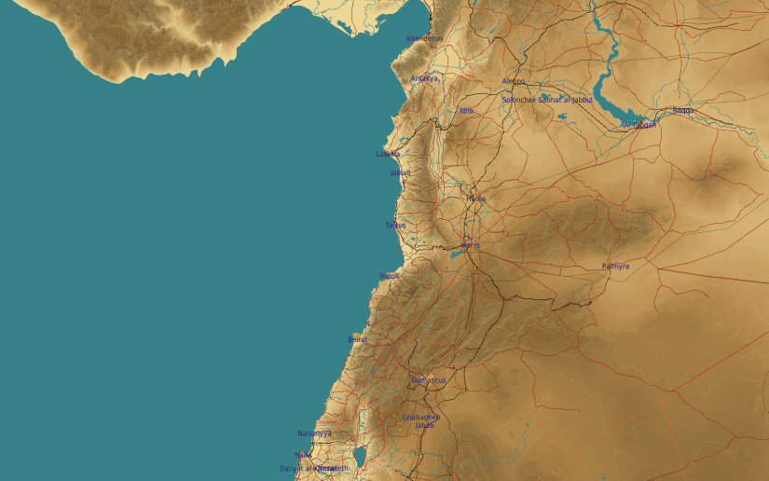
SYTGT091 Syrian Intelligence Office
N
2
091
DPI1
Cultural/historical site
DESCRIPTION OF THE DESIRED POINTS OF IMPACT WITH WPN TYPE:
SYTGT091 DPI 1: 6 story building, concrete and reinforced steel. DPI is center if the building. Assessed that a vault is located in the basement with critical radio equipment.
DPI 1 – N34 45.590 E036 17.744 / 1948ft (TLE CAT 1 Coordinates)
Recommended weapon: 4 x 500 Ibs bombs or 2x 1000 Ibs bombs
5
6
Collateral Concerns is the historical site SOUTH of the target.
7
8

Slide 2
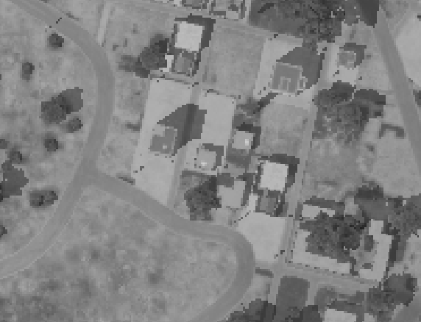
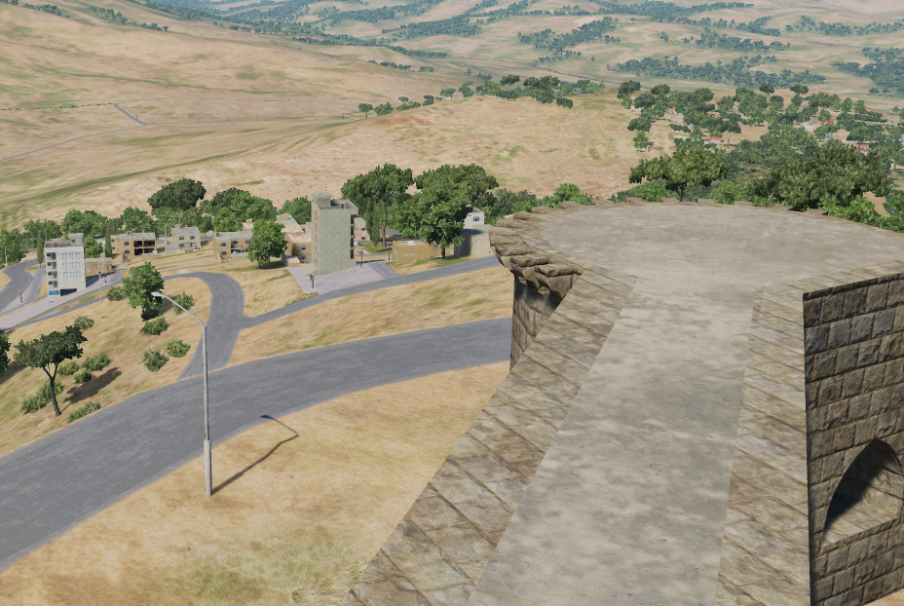
N
N
DPI1
DPI1

